Slide 1


DUAL AI ASSISTANT SYSTEM INTELLIGENT DOCUMENT QUESTION ANSWERING SYSTEM USING RETRIEVAL-AUGMENTED GENERATION (RAG) + SQL CHATBOT
Team Members:
Dev Patel & Brijesh Rakhasiya

Slide 2
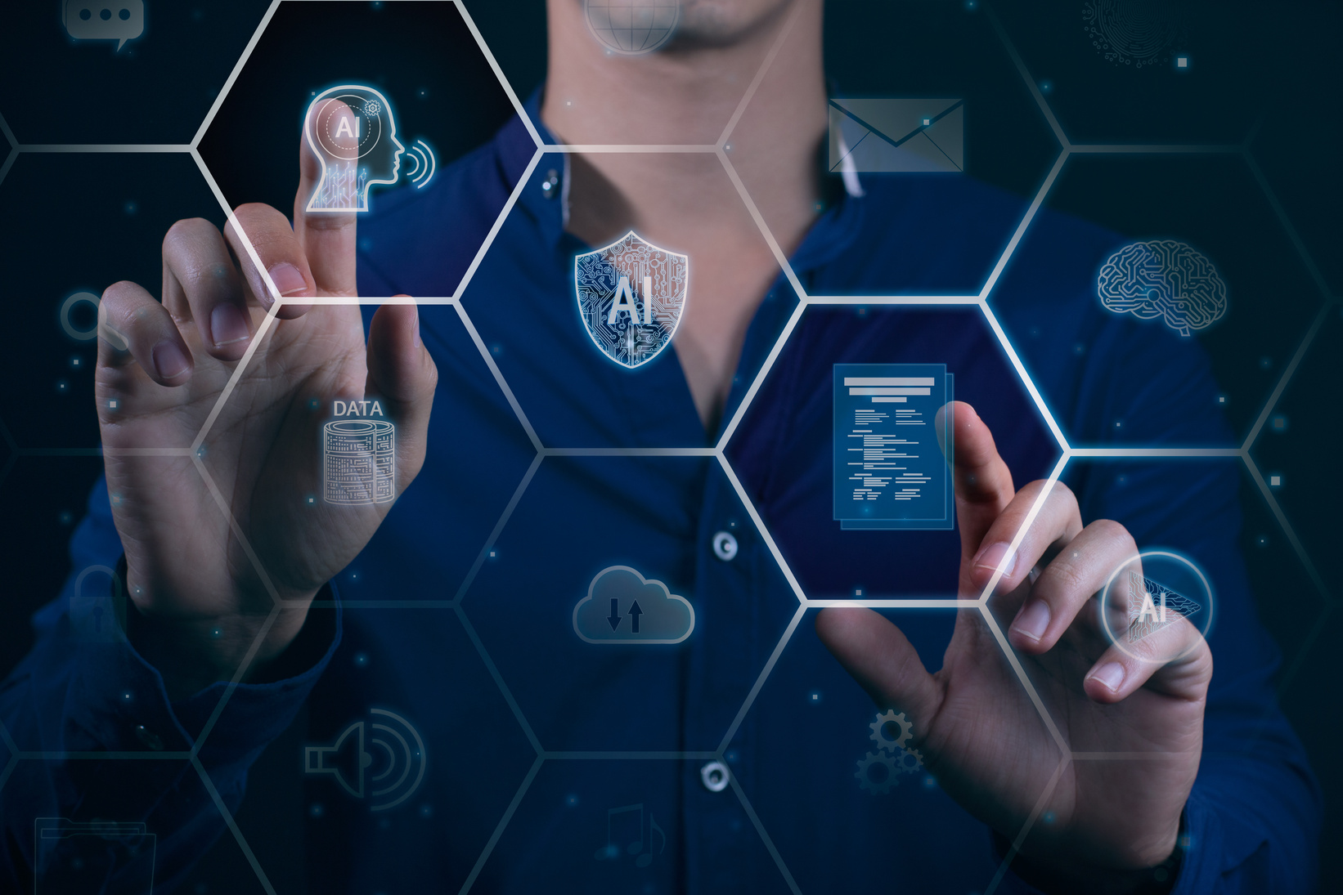
PROBLEM DEFINITION & MOTIVATION
Current Problems with Traditional Systems
Traditional chatbots cannot access external documents dynamically.
Users need accurate, context-aware answers from large knowledge sources.
Manual document search is time-consuming & inefficient.
Database queries require SQL knowledge that most users don't have.
Motivation: Use Retrieval-Augmented Generation (RAG) to:
Fetch relevant info from documents.
Generate precise, context-aware responses.
Convert natural language to SQL queries automatically.
Improve user experience in document-heavy tasks (e.g., academics, legal, corporate).

Slide 3

REQUIREMENTS & SCOPE
Functional Requirements:
Upload multiple document formats (PDF, TXT, DOCX)
Natural language question answering from documents
SQL database connection with user credentials
Convert English questions to SQL queries
Secure data handling and query validation
Technical Requirements:
Web-based user interface
Real-time document processing
Fast similarity search (vector database)
API integration for AI processing
Support for multiple SQL database types

Slide 4

SOLUTION APPROACH & TECH STACK
RAG Pipeline:
Document → Chunking → Embeddings → Vector Store → Retrieval → Generation
SQL Chatbot Flow:
English Query → AI Agent→ SQL Generation → Database Execution → Natural Response
Technology Stack:
Backend: Python
AI Processing: Groq API, HuggingFace Embeddings(all-MiniLM-L6-v2)
Database: FAISS (vectors), SQLAlchemy (SQL connections)
Frontend: Streamlit
Libraries: LangChain, Pandas, NumPy

Slide 5

PROJECT PLANNING & TEAMWORK
Team Members: Dev Patel & Brijesh Rakhasiya
Roles:
Dev Patel → Core development, SQL Chatbot
Brijesh Rakhasiya → RAG Implementation , Database, LangChain integration
Planning Steps:
Week 1: Setup repo & environment
Week 2: Notebook prototype (chatbot.ipynb)
Week 3: Script development (Multi_PDF_RAG.py, main.py)
Week 4: Database integration & final testing

Slide 6
PROJECT PROGRESS & DEMO
Document Q&A System:
Upload documents → Ask questions → Get accurate answers
Example: "What are the key findings in this research paper?"
Result: Extracts specific information with source citations
SQL Database Chatbot:
Connect with credentials → Ask in plain English → Get data results
Example: "Show me sales figures for last month"
Result: Generates SELECT * FROM sales WHERE date >= '2025-07-01'
Live Demo:
Real-time document upload and questioning
Database connection and natural language querying
Show response accuracy and processing speed

Slide 7
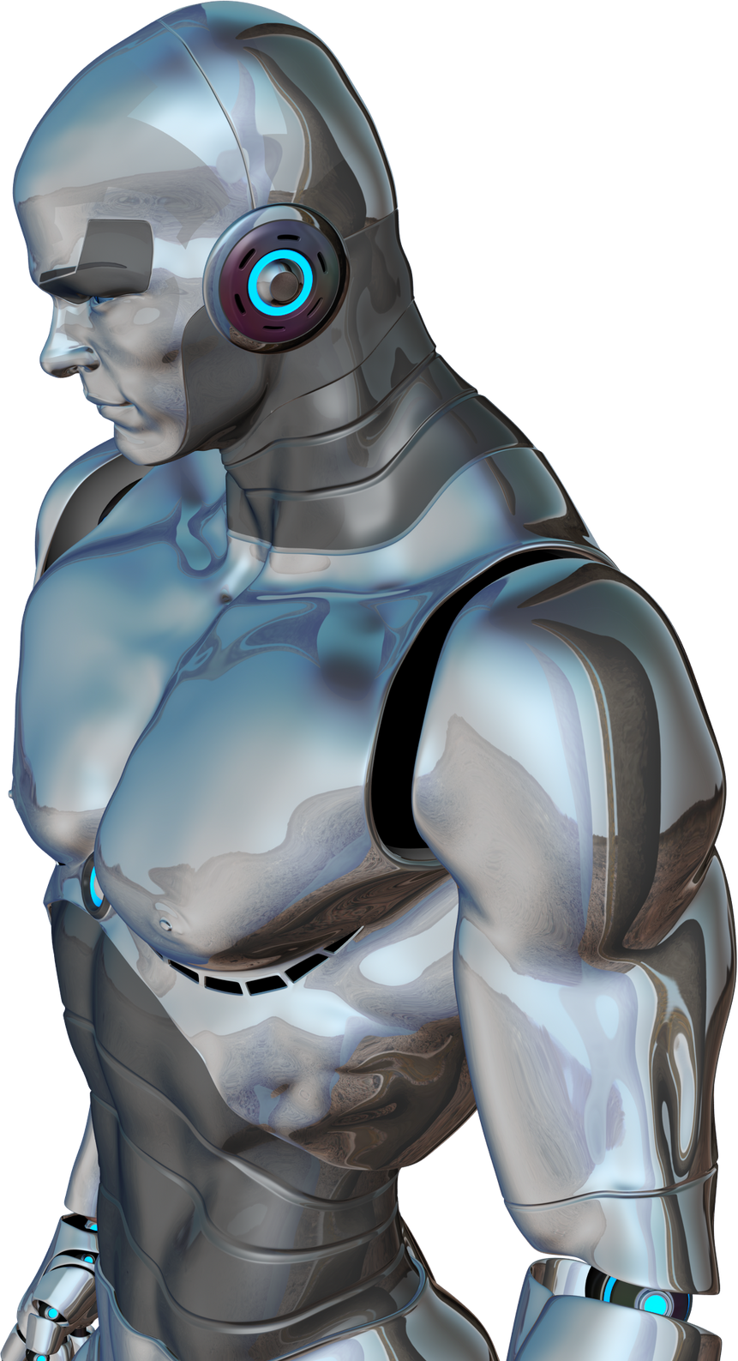
FUTURE WORK
Develop a web UI for easy access.
Add session memory for multi-turn conversations.
Improve retrieval with hybrid search (semantic + keyword).
Multi-language support for global usage.
Support more file formats (Excel, PowerPoint, Images)
Create data visualization for SQL query results

Slide 8
THANK YOU!
FOR YOUR ATTENTION

